Slide 1
AN EDA TECH HUB UPDATE
May 2024

Slide 2
EDA Tech Hub Basics
October 2023: Received Designation status—permits submission of a
Phase 2 Implementation Award
Key Elements
Designation status awarded to 31 regions
11 are health related
5-10 are expected to be approved
$541M has been appropriated. EDA expects average award is $45M if 10 Hubs approved.
Award notifications over summer; if successful, start date = 01 September
29 Feb 2024: Project Proposal Submitted
Virtual Site Visit 12 April 2024
June 2024: RUMOR of announcement (no confirmation as of 05/20)

Slide 3
Accomplishments in the interim
Continued advocacy for the Hub
Most legislators have submitted letters directly to Secretary Castillo (PA/DE contingent, Rep. Kim and Sen. Booker from NJ, Mayor Parker).
PA DCED Secretary Siger met with Castillo.
All received “thank you, no response” response.
Set up placeholder website (www.sep.benfranklin.org/propel)
Continued engagement to secure additional match to trigger Knight Foundation match
Need $100,000 to reach $2M private commitment requirement
Engagement with industry post-proposal
Help with non-Federal support opportunities to ensure sustainability beyond 5-year funding period.
Corporate

Slide 4
Tasks
Build plan if
1) we get award;
2) we get an award with a reduced budget;
3) we do not get award.
Identify and recruit 2 potential Steering Committee members
Engage those who volunteered to be part of an advisory committee
Develop Charter and sub-committees
Develop organizing documents: On HOLD until we hear.
Identify potential corporate partners
Identify potential foundation grant opportunities
Develop Communication plan (external & internal)

Slide 5
Tech Hub
Virtual Site Visit
APRIL 12, 2024 I Presented by PROPEL
LEAD MEMBER
Ben Franklin Technology Partners of Southeastern PA
REGION
Philadelphia-Camden-Wilmington MSA
Contact: Dr. Anthony P. Green I anthony.green@sep.benfranklin.org

Slide 6
Today’s Agenda
THE FUTURE
THE REGION
PRECISION MEDICINE + THE CHALLENGES
THE VISION
THE TEAM
THE WORKFORCE CENTER
THE BENEFICIARIES
THANK YOU

Slide 7
The Future
Aleister J. Saunders, Ph.D.
Executive Vice Provost for Research & Innovation,
Drexel University
“A once in a generation opportunity”

Slide 8
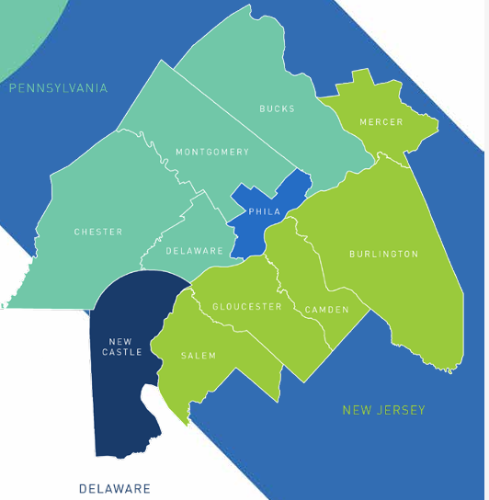
The Region
The Greater Philadelphia Region was
designated as an EDA Tech Hub for a reason.
Philadelphia is the 2nd largest U.S. city on the east coast
Ranked #11 in U.S. startup cities and #27 in the world
Philadelphia - Camden - Wilmington has a population of over 6.2 million
The fastest-growing millennial population among the largest U.S. cities
25% of the U.S. population resides within 5-hour drive
More top-100 universities than any other region in the country
(Sources: philadelphiadelivers, startup genome report, CRBE 2023)

Slide 9
The Region: Precision Medicine
The Greater Philadelphia Region was
designated as an EDA Tech Hub for a reason.
Philadelphia was ranked 8th-best market for Life Sciences talent
8,000 + jobs in Precision Medicine
15% of the Life Science workforce, and growing
The Region is home to 400+ key suppliers and vendors to the Life Science ecosystem
Current lab space for Life Sciences is 3M sq. ft. with another 1M in development
The Region is participating in over 150 active clinical trials in Precision Medicine
This January, Aissam Dam, an eleven-year-old boy, was the first person to receive gene therapy in the U.S. for congenital deafness from the Children’s Hospital of Philadelphia, allowing him to hear.
Source: The Chamber of Commerce for Greater Philadelphia

Slide 10
Precision Medicine + The Challenges
Challenges we face
Equitable workforce practices
Capacity to train
diverse workforce
Finding qualified
& available workforce
Representation in clinical trials
What is Precision Medicine?
Precision Medicine is a modern healthcare approach that considers each person's unique genes, surroundings, and lifestyle when providing medical treatment.
Speed to market
Coordination across
multi-sector partners

Slide 11
The Vision
Our collaborative alliance as the Hub will catalyze the next generation of health interventions, and improve national health equity, security, and economic opportunity.
Workforce
Philadelphia Works & Tech Council of Delaware
Governance
Ben Franklin
Entrepreneurship
Delaware Innovation Space & Ben Franklin
Biomanufacturing
University of Delaware/NIIMBL
Access
HealthShare Exchange, Drexel University, & Virtua Health

Slide 12
The Team
PROPEL is led by Ben Franklin Technology Partners of Southeastern Pennsylvania and supported by over 70 regional partners.

Slide 13
Governance
Entrepreneurship
The Team
Biomanufacturing
DR. TONY GREEN
Ben Franklin
SANIAH JOHNSON
Ben Franklin
MICHELLE ATHERTON
Ben Franklin
JOHN SWARTLEY
University of Pennsylvania
BILL PROVINE
Innovation Space
SRI SRIADIBHATLA
Ben Franklin
Workforce
KELVIN H. LEE
National Institute for Innovation in Biopharmaceuticals (NIIMBL)/University of Delaware
BILL REPETTO
NIIMBL/ University of Delaware
MICHAEL MCCORMICK
NIIMBL/ University of Delaware
ZAKIYYAH ALI
Tech Council of Delaware
PATRICIA BLUMENAUER
Philadelphia Works
TYRONE HAMPTON
Philadelphia Works
Access
GREG LIPTAK
HealthShare Exchange
REG BLABER
Virtua Health
KENNY SIMANSKY
Drexel University College of Medicine
GWYNNE GRASBERGER
Drexel University
ALEISTER SAUNDERS
Drexel University
DIANNE LANGFORD
Rowan University

Slide 14
THE WORK
Workforce Center
for Precision Medicine
A Centralized, Hub-based Talent Center
ZAKIYYAH ALI
TECH COUNCIL OF DELAWARE

Slide 15
Companies/Employers
“Virtua Health can’t do it alone.”
Reg Blaber, Executive Vice President
and Chief Clinical Officer at Virtua Health

Slide 16
The Current State
There are few training programs focused
on middle-skill Precision Medicine positions.
There are no programs training workers for multidisciplinary roles
or preparing talent to work in a Precision Medicine Tech Hub.
How do we deliver new AI training to our team?
THE WISTAR INSTITUTE EMPLOYER

Slide 17
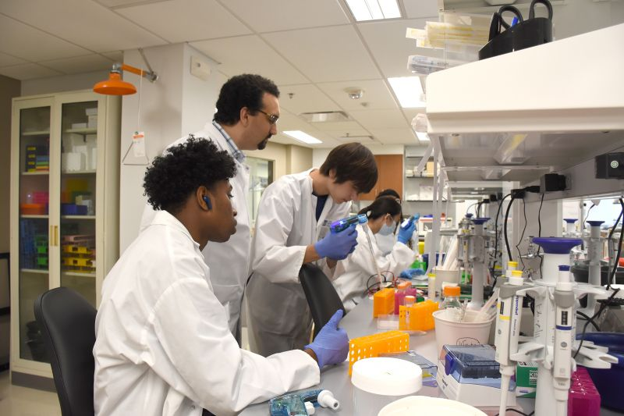
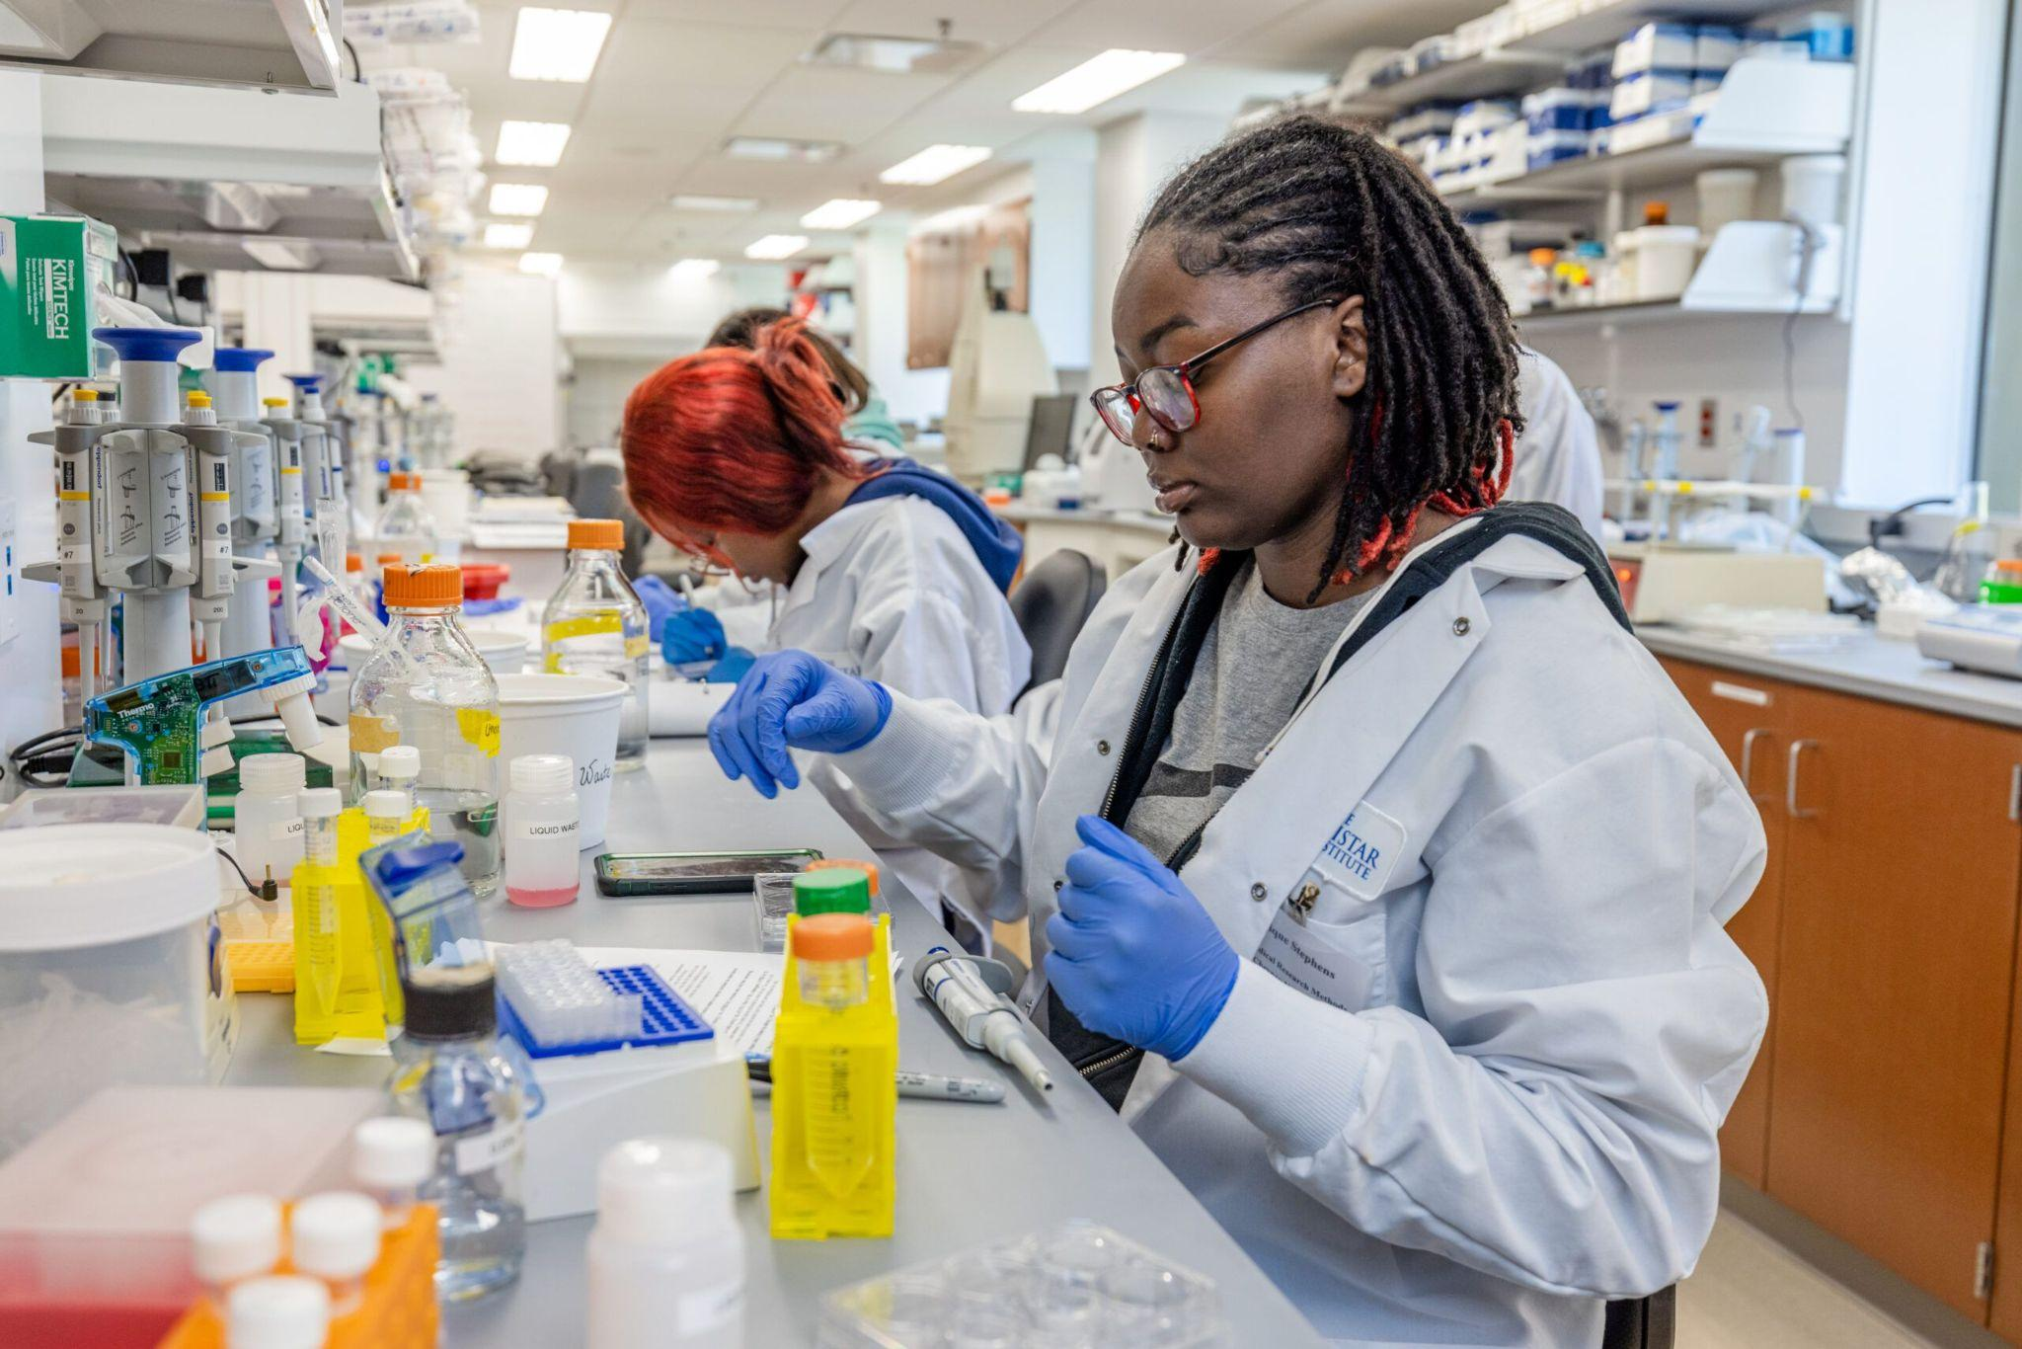
Introducing the Workforce Center
The Workforce Center for Precision Medicine is the proposed vehicle by which the PROPEL Tech Hub can implement a Hub-Based Workforce Model.
Centralized Operations*
Earn-and-Learn Model
Temp-to-Permanent Placement Strategy
Employer-Led Program Design & Talent Development
*recruitment, training, placement, & ongoing support.
Trainees are hired by employer of record in temporary role, compensated during training, and promoted into permanent role upon program completion.

Slide 18
A Win-Win-Win
The Region & Patients
Nuanced Opportunities
Hub
Employers
Attracts new employers
Direct outreach to career seekers
Workforce
Center for Precision Medicine
Collaboration across
multi-sector organizations
Employer-led programs
Career Seekers & Employees
Cross-state talent pool
Shared resources & partners
A centralized, Hub-based talent center
that communicates across the network.

Slide 19
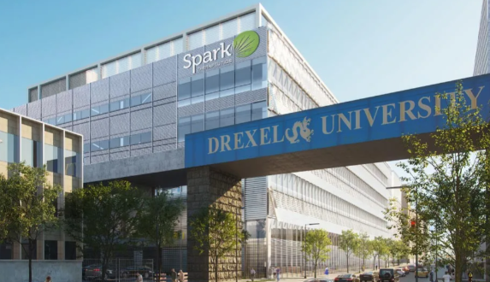
Employer-led Workforce Development
Year 1
Collaborate with Employers
Workforce intermediaries and Hub employers work together to reimagine more effective talent development approaches that meet the needs of, and benefit, all stakeholders.
Talent Development Options
Direct Placement
Talent Deployment

Slide 20
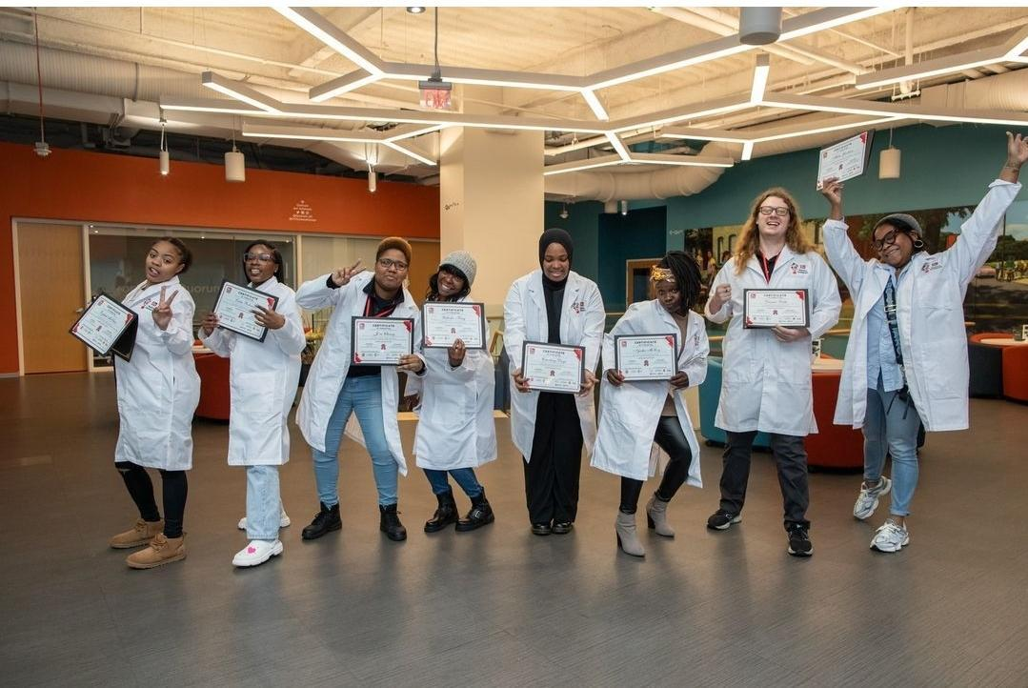
Option 1: Direct Placement
Direct Placement
is a good option for
Program graduates are hired into a permanent role by a Hub company.
Employers seeking to fill full-time positions
1
Cohort is launched
The Workforce Center collaborates with Hub companies & partners to launch a cohort
2
Managed from within
The Workforce Center coordinates recruitment, assessment, selection,
and hire into temporary position with employer
of record*
3
Services are procured
The Workforce Center contracts for training delivery and supportive services
Career seekers who want to work for a specific Hub company
4
Graduates are placed
Graduates transition into permanent employment with Hub company
5
Hub Employers reach their workforce goals
Hub company hires, retains, and supports new employees
*Hub company covers program participant wages during training

Slide 21
Option 2: Talent Deployment
Talent Deployment is a good option for
Program graduates promoted into permanent role by, and with, employer of record.
Companies seeking to leverage the workforce for specific durations or projects; and for Startups
1
Cohort is created
The Workforce Center collaborates with Hub companies & partners to launch a cohort
2
Managed from within
The Workforce Center coordinates recruitment, assessment, selection,
and hire into temporary position with employer
of record*
Company A
Company B
Propel Tech Hub
Employer of Record
3
Services are procured
The Workforce Center contracts for cohort training and supportive services
4
Graduates are placed
Graduates promoted into permanent position with employer of record**
Company C
*Hub company covers program participant wages during training
**Hub company covers program graduates’ compensation (salary and fringe) upon permanent hire by employer of record

Slide 22
Beneficiaries
Priority Populations (80% of our trainees)
Direct beneficiaries of the Workforce Center for Precision Medicine include Hub companies/employers, career seekers (particularly those from priority populations and K-12 students).
Low-income career seekers
Workers in low-wage jobs
& occupations
People of color
Career Seekers
STARs / non-degree holders
Renters
Residents receiving public benefits
Hub
Employers
Justice-involved

Slide 23
Testimonials

Slide 24
Thank you
APRIL 12, 2024 I Presented by PROPEL
LEAD MEMBER
Ben Franklin Technology Partners of Southeastern PA
REGION
Philadelphia-Camden-Wilmington, PA-NJ-DE-MD MSA
Contact: Dr. Anthony P. Green I anthony.green@sep.benfranklin.org

